Slide 1
UML Unified Modeling Language
统一建模语言
Lecture_ 类与关系_实践
主讲: 姜宁康 博士
日期: 26/11/8

Slide 2
review:
UML的构造块
UML
事物
关系
图
结构事物
行为事物
分组事物
类图 Class D.
依赖
对象图 Object D.
类 Class
交互 Interaction
注释事物
顺序图 Sequence D
关联
接口Interface
状态机 State machine
泛化
通信图 Communication D
用例图 use case D.
包 Package
协作 Collaboration
活动 Activity
实现
构件图 Component D.
状态图 state D.
注释
Anotational thing
用例 Use case
活动图activity D.
构件Component
部署图 deployment D.
制品图 artifact D.
主动类 Active class
制品 Artifact
包图package D.
交互概览图 interaction overview D.
节点 node
时序图 timing D.
UML Lecture_UMLintroduction, Author: NK Jiang

Slide 3
How to Create Class Diagrams
To create and evolve a class diagram, you need to iteratively model:
  Classes
  Responsibilities
  Associations
  Inheritance relationships
  Composition/Aggregation associations
  Adorments
  Extend mechanism
    Stereotype
    Taged value
    Constraint
  Interfaces
  Etc,….

Slide 4
提示：类的寻找策略
类的寻找策略
  (1) 从用例模型的事件流中寻找名词或名词词组，将性质相同的归为一类，或性质、内容值正负相反的归为一类
  (2) 去除不恰当的、与含糊的类别，去除应是归类为属性的项目
  (3) 给这些类取个合适的名字，在现实系统实现时，可以参照真实系统相关的命名规约
UML Lecture_01, Author: NK Jiang
<number>/19

Slide 5
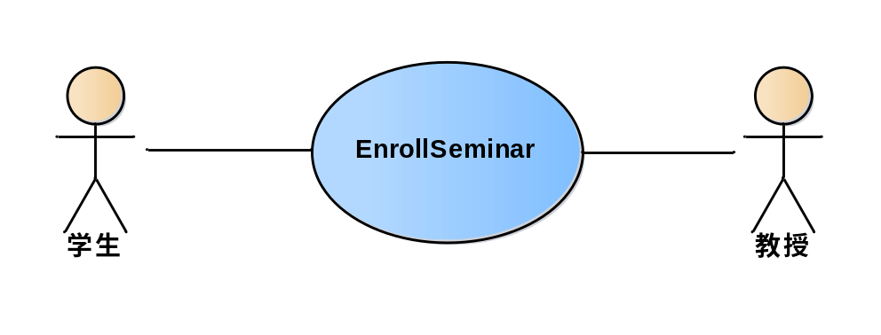
Ex1
需求描述
  学生（student）可以参加（enrollment）教授（professor）指导的兴趣小组(seminar)
用例模型
UML Lecture, Author: NK Jiang
<number>/19

Slide 6
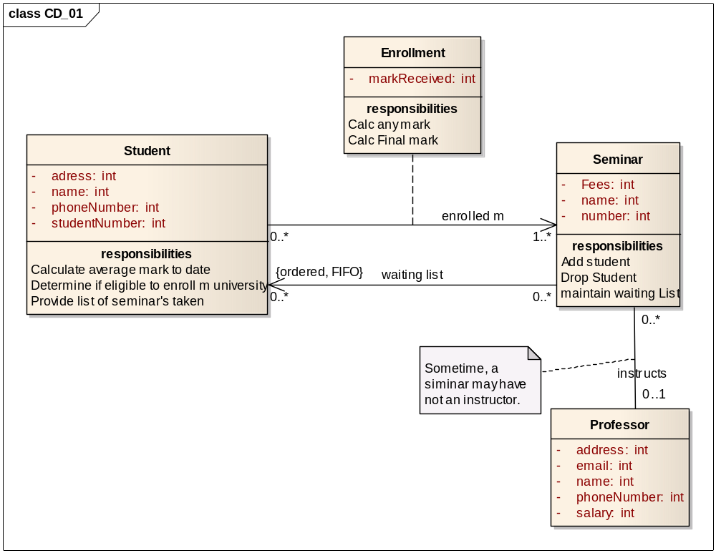
Ex_1: 类图（参考答案）

Slide 7
Ex2: Draw A class diagram
Class: Tape
  Contains: 0..N Messages
  Attribute: Size
  Attribute: Position
  Behavior: Record()
  Behavior: Play()
Class: Message
  Attribute: Length
  Behavior: Record()
  Behavior: Play()
Class: Greeting
  Inherits From: Message
  Attribute: Mode
  Attribute: Greeting
  Behavior: Record()
  Behavior: Play()
Class: Caller Message
  Inherits From: Message
  Attribute: DateTime
  Attribute: Caller
  Attribute: Reviewed
  Behavior: Record()
  Behavior: Play()

Slide 8
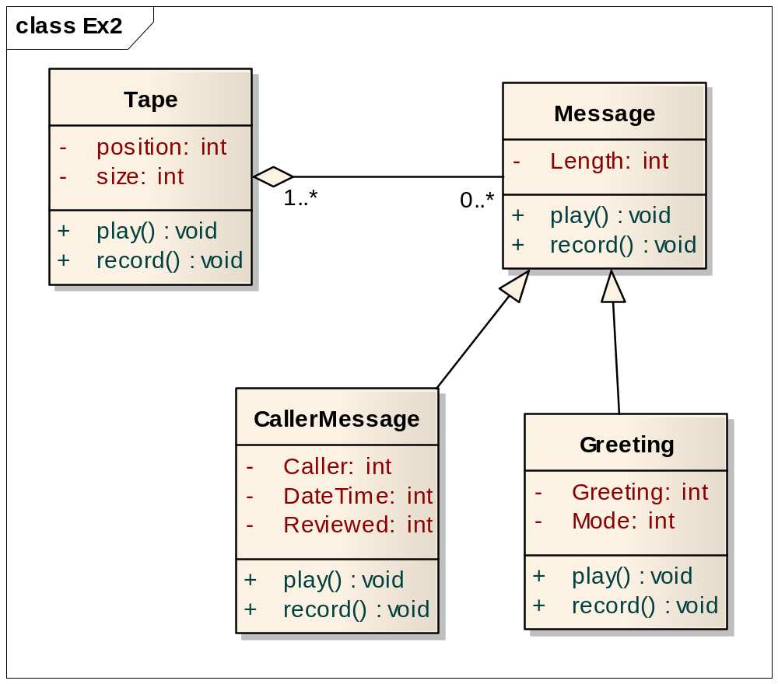
Ex2： 参考答案

Slide 9
Ex3 :Draw Associations between Classes
The class diagram in figure expresses the following issue about a car management system:
  1 A person can have up to three companies as employer.
  2 The employer IDs are equal to the company IDs the person is working for.
  3 Cars can be owned by persons, companies or banks.
  4 The car owner ID is equal to the ID of the person, the company or the bank owning the car.
  5 The purchase of a car may be associated with a car credit granted by a bank.
Req:
Draw a class diagram.
Introduce generalizations where useful. Try to determine the multiplicities correctly.
UML Lecture_01, Author: NK Jiang
<number>/19

Slide 10
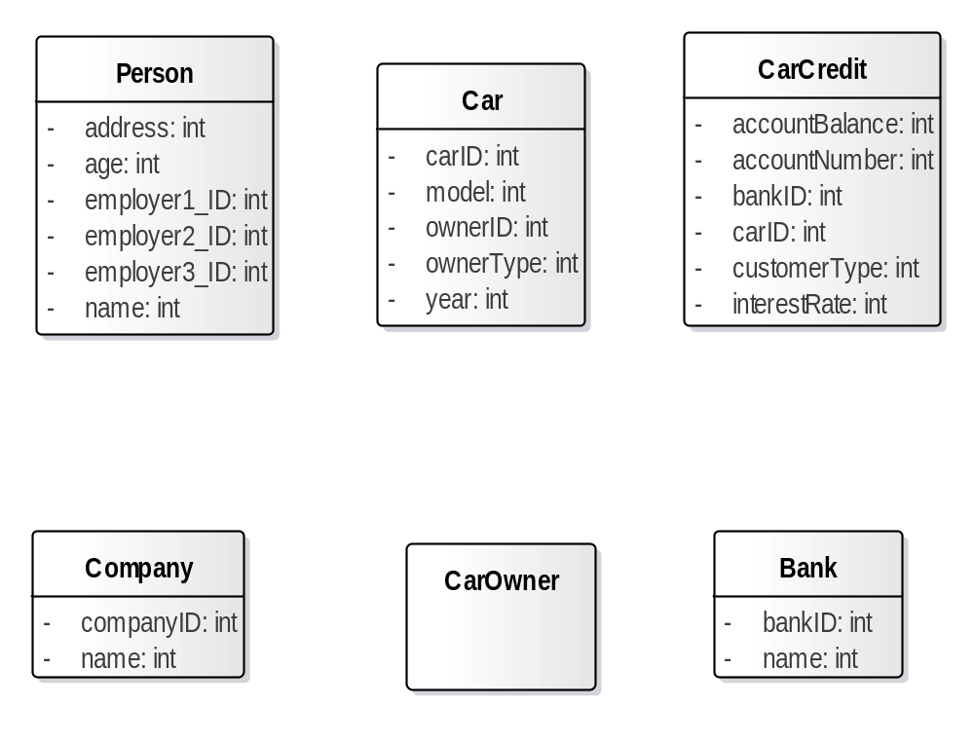
Ex3: 参考答案
第一步 ：找到 类、根据信息定义类的属性
UML Lecture, Author: NK Jiang
<number>/19

Slide 11
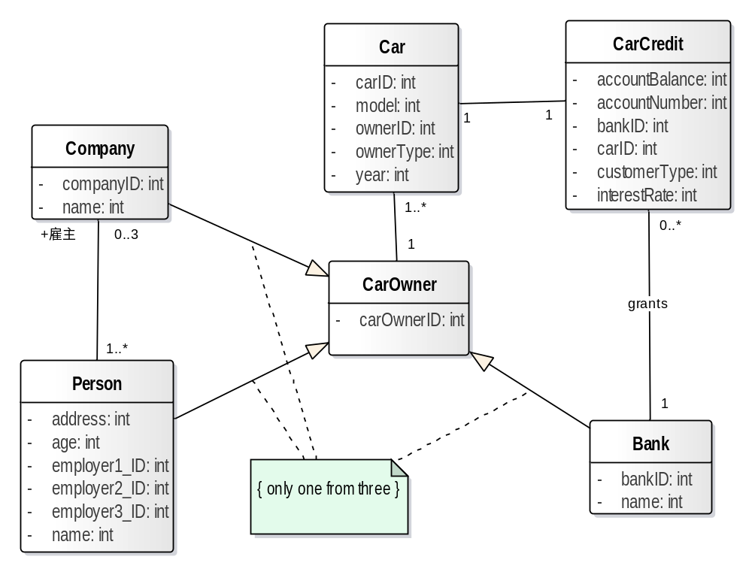
Ex3: 参考答案
第二步 定义 类之间的关系、多重性
UML Lecture, Author: NK Jiang
<number>/19

Slide 12
Ex_4: Draw a class diagram
NRB bank manages a number of customer accounts. A customer can have one of three types of accounts, namely, a cheque account, a savings account or a loan account.
Details that need to be stored for each customer include the customers ID number,name, address and telephone number. Each account has an account number and balance. Money can be withdrawn from an account or deposited into the account.
In the case of both the savings and cheque accounts a withdrawal results in the balance being decreased while in the case of a loan account the balance is increased. Similarly, a deposit results in the balance being increased for the cheque and savings accounts and decreased for the loan account.
For each cheque account the customer’s profile, can be gold, silver or bronze. This information needs to be stored for each cheque account as accounts in these different categories have different benefits.
Whenever a deposit is made into a savings account the customer earns interest on the updated balance at a given rate. The interest rate used needs to be stored for each savings account.
Additional information needed for each loan account includes the duration of the loan in months, loan limit, and the monthly instalments(分期付款).

Slide 13
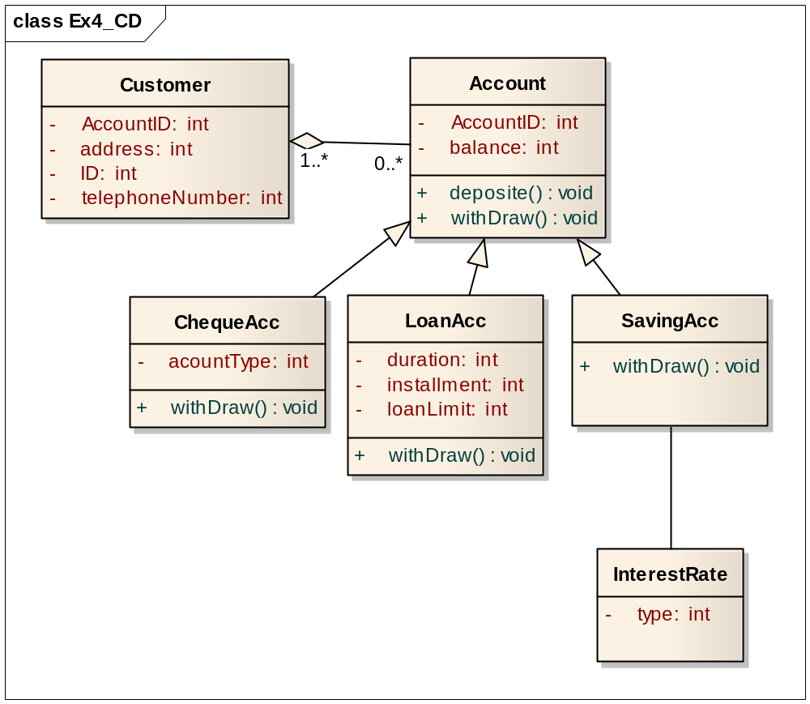
Ex4：参考答案

Slide 14
实例5
Video Store
  Many customers
  Rent, return videos
  Customer number videos rented
  Video rent date / due date
Req：
  Please find classes and draw Class Diagram
UML Lecture_01, Author: NK Jiang
<number>/19

Slide 15
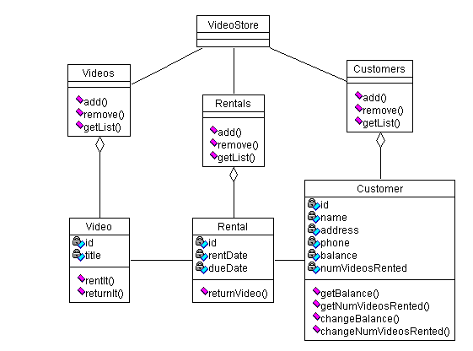

Ex5：参考答案
插入数据库接口
UML Lecture_01, Author: NK Jiang
<number>/19

Slide 16
Ex6 : University Courses
Some instructors are professors, while others have job title adjunct
Departments offer many courses, but a course may be offered by >1 department
Courses are taught by instructors, who may teach up to three courses
Instructors are assigned to one (or more) departments
One instructor also serves a department chair
UML Lecture_01, Author: NK Jiang
<number>/19

Slide 17
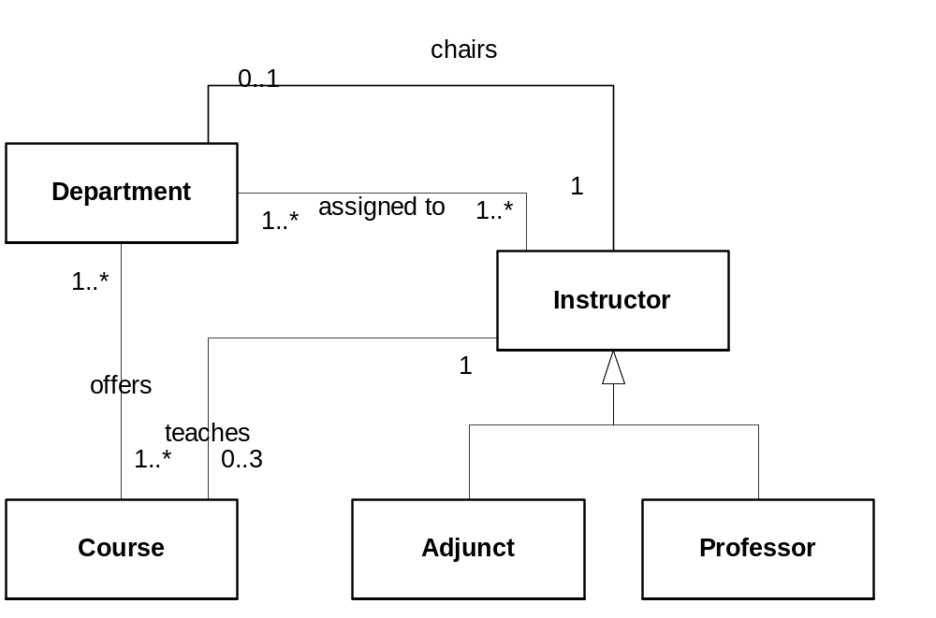
Ex6：参考答案
UML Lecture_01, Author: NK Jiang
<number>/19

Slide 18
作业：UML_W07
Class Diagram of a Banking Software
You are a software developer working in a company which develops bank software systems.
A customer has sent the following short description of a new software system:
A person becomes a customer, if she or he opens an account. A customer can open an
arbitrary number of additional accounts. For every new customer the name (which may be
ambiguous), the address, the date, when she or he has opened the first account, are recorded.
At the opening of an account the customer has to do a first deposit. We distinguish current
accounts and savings accounts. Current accounts may be overdrawn up to a predetermined
amount. For every account an individual rate of interest on credit is fixed and for current
accounts an individual rate of interest charges, too. In addition, every account has an
unambiguous account number. About every savings account the kind of saving, e.g. fixedterm
deposit account, is stored. A customer can deposit and withdraw amounts. Furthermore
the interest on credit is credited and in case of current accounts interest charges are debited. In
order to calculate the amount of interest the date and the amount of every transaction has to be
noted down. The credit advice/direct debiting of the interest takes place annually in case of
savings accounts and quarterly for current accounts. A customer may liquidate each of his
accounts if she or she wants to. When liquidating her or his last account the person ceases
being a customer.
Req：
1）Identify the classes, attributes, operations, associations and inheritance structures in the
description above
2）and draw a class diagram.
UML Lecture_01, Author: NK Jiang
<number>/19

Slide 19
End.
UML Lecture, Author: NK Jiang
<number>/19

